Slide 1
Course Title: Engineering Chemistry-1
Course Code: CHE109
(Chapter 3)
Dr. Joyanta Kumar Saha
Associate Professor
Department of Chemistry
Jagannath University

Slide 2
Chemical Bonding
Molecules of chemical substances are made of two or more atoms joined together by some force, acting between them. This force which results from the interaction between the various atoms that go to form a stable molecule, is referred to as a Chemical Bond.
A chemical bond is defined as a force that acts between two or more atoms to hold them together as a stable molecule.
As we will study later, there are three different types of bonds recognised by chemists :
(1) Ionic or Electrovalent bond (2) Covalent bond (3) Coordinate covalent bond
Ionic Bond: This type of bond is established by transfer of an electron from one atom to another.

Slide 3
Therefore, A transfers an electron to B and in this transaction both the atoms acquire a stable electronoctet. The resulting positive ion (cation) and negative ion (anion) are held together by electrostatic attraction.
The electrostatic attraction between the cation (+) and anion (–) produced by electron-transfer constitutes an Ionic or Electrovalent bond.
CONDITIONS FOR FORMATION OF IONIC BOND
(1) Number of valence electrons (2) Net lowering of Energy: To form a stable ionic compound, there must be a net lowering of the energy. (3) Electronegativity difference of A and B: Atoms A and B if they have greatly different electronegativities, only then they will form an ionic bond. FACTORS GOVERNING THE FORMATION OF IONIC BOND (1) Ionisation Energy: Lower the ionisation energy greater will be the tendency of the metal atom of change into cation and hence greater will be the ease of formation of ionic bond. That is why alkali metals and alkaline earth metals form ionic bonds easily.

Slide 4
(2) Electron Affinity: Higher the electron affinity more is the energy released and stable will be the anion formed.
(3) Lattice Energy : Lattice energy the amount of energy released when one mole of an ionic compound is formed from its cations and anions.

Slide 5
COVALENT BOND : A shared pair of electrons constitutes a Covalent bond or Electron-pair bond. The attractive force between atoms created by sharing of an electron-pair. The compounds containing a covalent bond are called covalent compounds.
CONDITIONS FOR FORMATION OF COVALENT BOND
(1) Number of valence electrons (2) Equal electronegativity (3) Equal sharing of electrons

Slide 6
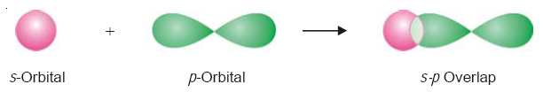
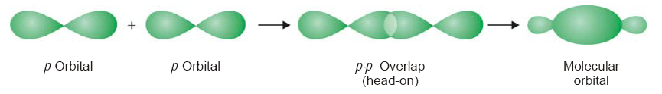
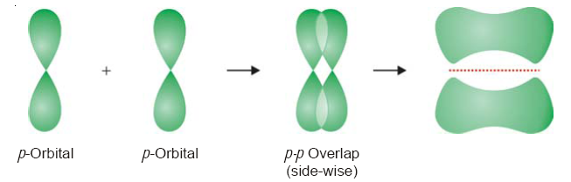
Types of overlapping and Nature of Covalent Bond: Sigma (σ) Bond:
1) s – s overlapping: Here s-orbital of one atom overlaps with the s-orbital of other atom. An example of this type of overlapping is the formation of hydrogen molecule from two H-atoms.
2) s – p overlapping: In this type of overlap s-orbital of one atom overlaps with the half filled p-orbital of the other atom.
3) p – p overlapping: Here p-orbital of one atom overlaps with the p-orbital of the other atom on internuclear axis.
Pi (π) Bond: This type of covalent bond is formed by the sidewise overlap of the half filled
atomic orbital.

Slide 7
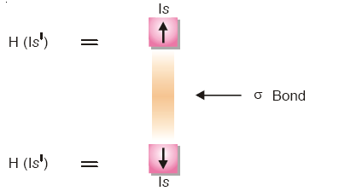
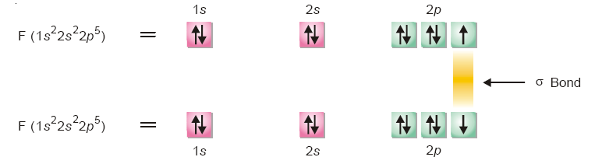
Strength of σ and π bonds: The strength of a covalent bond depends upon the extent of overlapping between the atomic orbitals of participating atoms. During the formation of σ bond the extent of overlapping is more and hence a Sigma bond is stronger than Pi bond.
ORBITAL REPRESENTATION OF MOLECULES
(a) Formation of H2 molecule
(b) Formation of F2 molecule

Slide 8
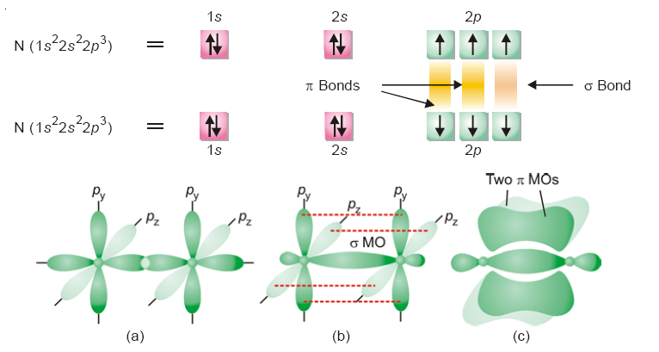
(c) Formation of Nitrogen molecule

Slide 9
CHARACTERISTICS OF COVALENT COMPOUNDS (1) Gases, liquids or solids at room temperature: The covalent compounds are often gases, liquids or relatively soft solids under ordinary conditions. This is so because of the weak intermolecular forces between the molecules. (2) Low melting points and boiling points: Covalent compounds have generally low melting points (or boiling points). The molecules are held together in the solid crystal lattice by weak forces.
(3) Neither hard nor brittle: While the ionic compounds are hard and brittle, covalent compounds are neither hard nor brittle. There are weak forces holding the molecules in the solid crystal lattice. (4) Soluble in organic solvents: In general, covalent compounds dissolve readily in nonpolar organic solvents (benzene, ether).
(5) Non-conductors of electricity: Since there are no (+) or (–) ions in covalent molecules, the covalent compounds in the molten or solution form are incapable of conducting electricity.
(6) Exhibit Isomerism: covalent compounds exhibit stereoisomerism.
(7) Molecular reactions: The covalent compounds give reactions where the molecule as a whole undergoes a change. Since there are no strong electrical forces to speed up the reaction between molecules, these reactions are slow.

Slide 11
HYDROGEN BONDING (H-Bonding): The electrostatic attraction between an H atom covalently bonded to a highly electronegative atom X and a lone pair of electrons of X in another molecule, is called Hydrogen Bonding.
CONDITIONS FOR HYDROGEN BONDING (1) High electronegativity of atom bonded to hydrogen: The molecule must contain an atom of high electronegativity such as F, O or N bonded to hydrogen atom by a covalent bond. The examples are HF, H2O and NH3.
(2) Small size of Electronegative atom: The electronegative atom attached to H-atom by a covalent bond should be quite small. Smaller the size of the atom, greater will be the attraction for the bonded electron pair. In other words, the polarity of the bond between H atom and electronegative atom should be high. This results in the formation of stronger hydrogen bonding. For example, N and Cl both have 3.0 electronegativity. But hydrogen bonding is effective in NH3 in comparison to that in HCl. It is due to smaller size of N atom than Cl atom.

Slide 12
CHARACTERISTICS OF HYDROGEN-BONDED COMPOUNDS
Abnormally high boiling and melting points: It will be noticed that there is a trend of decrease of boiling and melting points with decrease of molecular weight from H2Te to H2S. But there is a sharp increase in case of water (H2O), although it has the smallest molecular weight. The reason is that the molecules of water are ‘associated’ by hydrogen bonds between them, while H2Te, H2Se and H2S exist as single molecules since they are incapable of forming hydrogen bonds.
High solubilities of some covalent compounds.
Three dimensional crystal lattice.
METALLIC BONDING: The peculiar type of bonding which holds the atoms together in metal crystal is called the Metallic Bonding. The valence bonds that hold the atoms in a metal crystal together are not ionic, nor are they simply covalent in nature. Ionic bonding is obviously impossible here since all the atoms would tend to give electrons but none are willing to accept them.

Slide 13
CONCEPT OF HYBRIDIZATION: we may mix any number of atomic orbital of an atom, which differ in energy only slightly, to form new orbital called Hybrid orbital.
RULES OF HYBRIDIZATION
(1) Orbital on a single atom only would undergo hybridization.
(2) There should be very little difference of energy level between the orbital mixing to
form hybrid orbital.
(3) Number of hybrid orbital generated is equal to the number of hybridizing orbital.
(4) The hybrid orbital assume the direction of the dominating orbital.
(5) It is the orbital that undergo hybridization and not the electrons.
(6) The electron waves in hybrid orbital repel each other and thus tend to be farthest
apart.

Slide 14
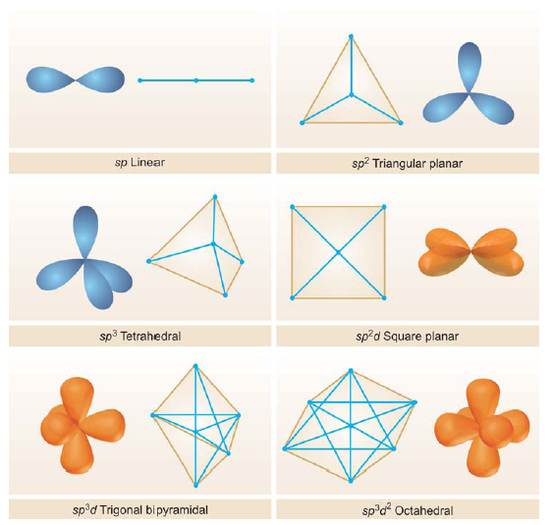
TYPES OF HYBRIDIZATION
(a) sp Hybridization
(b) sp2 Hybridization
(c) sp3 Hybridization
(d) Hybridization involving d orbital, sp3d2, sp2d

Slide 15
BOND FORMATION (VALENCE BOND THEORY, V.B.T)
The essential conditions for the overlap of electron waves of orbital are :
The orbitals entering into combination must have only one electron.
(2) The atoms with valence or bonding orbital (half-filled) should approach sufficiently close to one another with the axis of their orbitals in proper alignment.
The strength of a covalent bond depends upon the extent of overlapping. Greater the overlapping between the atomic orbitals stronger is the bond formed between the two atoms.
The amount of energy given off or released per mole at the time of overlapping of atomic orbitals to form a bond is termed as Bond Energy or Stabilisation Energy.
This equilibrium distance at which the two atomic nuclei are now held is called the Bond length.

Slide 16
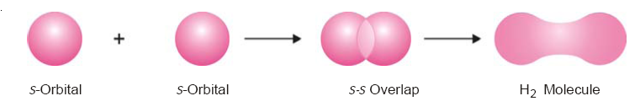
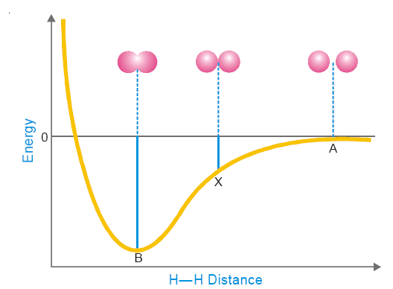
Formation of H2 molecule: For the H2 molecule, the bond length is 0.74 Å and bond energy is 103.2 kcal/mole.

Slide 17
Types of overlapping and Nature of Covalent Bond: Sigma (σ) Bond:
1) s – s overlapping: Here s-orbital of one atom overlaps with the s-orbital of other atom. An example of this type of overlapping is the formation of hydrogen molecule from two H-atoms.
2) s – p overlapping: In this type of overlap s-orbital of one atom overlaps with the half filled p-orbital of the other atom.
3) p – p overlapping: Here p-orbital of one atom overlaps with the p-orbital of the other atom on internuclear axis.
Pi (π) Bond: This type of covalent bond is formed by the sidewise overlap of the half filled
atomic orbital.

Slide 18
Strength of σ and π bonds: The strength of a covalent bond depends upon the extent of overlapping between the atomic orbitals of participating atoms. During the formation of σ bond the extent of overlapping is more and hence a Sigma bond is stronger than Pi bond.
ORBITAL REPRESENTATION OF MOLECULES
(a) Formation of H2 molecule
(b) Formation of F2 molecule

Slide 19
(c) Formation of Nitrogen molecule

Slide 20
Structure of Molecules
VSEPR (Valence-Shell Electron Pair Repulsion) THEORY: The electron pairs (both lone pairs and shared pairs) surrounding the central atom will be arranged in space as far apart as possible to minimize the electrostatic repulsion between them.
Multiple bonds behave as a single electron-pair bond for the purpose of VSEPR. They represent a single group of electrons.
Order of repulsions between lone pair and lone pair (lp-lp), lone pair and bonding pair (lp-bp), and bonding pair and bonding pair (bp-bp) is
lp – lp > > lp – bp > bp – bp
When a molecule has lone pairs of electrons, the bonding electron pairs are pushed closer and thus the bond angle is decreased.

Slide 21
(1) Linear Molecules
(a) Beryllium chloride, BeCl2.
(b) Carbon dioxide, CO2
(2) Trigonal Planar Molecules
(a) Boron trifluoride, BF3

Slide 22
(3) Tetrahedral Molecules
(a) Methane, CH4.
(4) Pyramidal Molecules
(a) Ammonia molecule.
a lone pair exerts greater repulsion on the bonding electron pairs than the bonding pairs do on each other

Slide 23
(5) Bent or Angular Molecules
(a) Water, H2O.
VSEPR theory says that in order to secure maximum separation between them, the four electron pairs are directed to the corners of a tetrahedron. If we look at the three atoms (and ignore the unshared pairs), the atoms HOH lie in the same plane and the predicted bond angle is 109.5º. But with two unshared pairs repelling the bonding pairs, the bond angle is compressed to 105º, the experimental value. Thus the H2O molecule is flat and bent at an angle at the O atom. Such a molecule is called a bent molecule or angular molecule.

